Slide 1

Claiming Control
How to Be Your Own Best Advocate After Cancer
Ambreen Maan, MSW, LSW
Director of Programs

Slide 2
What We’ll Cover
What self-advocacy means and why its important
Core self-advocacy skills
Self-advocacy strategies to apply throughout the cancer trajectory
How to access resources and support

Slide 3
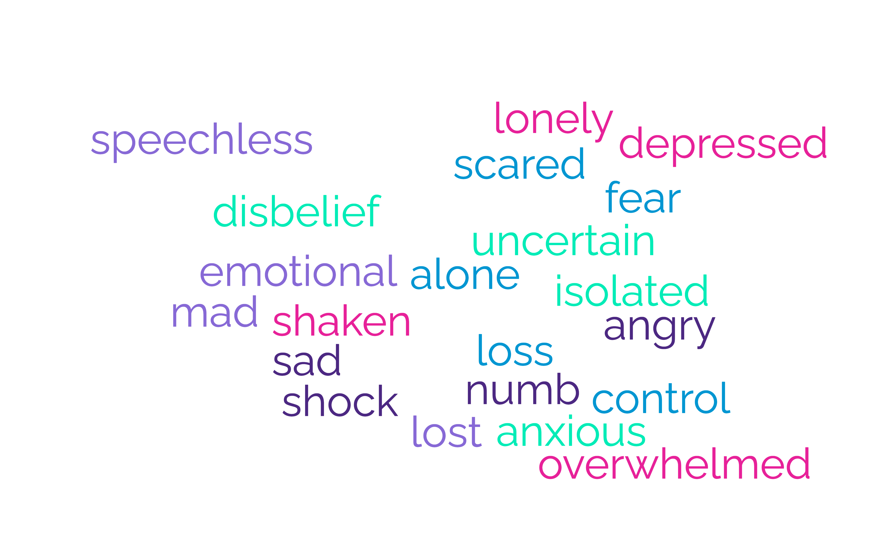
“You Have Cancer”

Slide 4
Self Advocacy
The ability to speak or act on your own behalf/ability to understand & communicate your needs effectively to other individuals
Empowering yourself by choosing to take a more active role in your cancer care to ensure your needs, values, and wishes are heard and met

Slide 5
Why is Self Advocacy Important?
Assuring you are receiving quality care
Gaining back control
Connection with your health care team, support system, or other survivors
Building confidence in your voice and who you are
Improving your quality of life
Navigating the healthcare system from an informed standpoint

Slide 6
Self Advocacy
is synonymous with control and empowerment

Slide 7
Core Self Advocacy Skills
Information Seeking
Communication
Problem Solving
Negotiating

Slide 8

Information Seeking
Become an informed survivor
Diagnosis
Treatment Options
Symptoms & Side Effects
Resources

Slide 9
Tips on Information Gathering
Start with your doctor or treatment center
Use trusted sources
Check out organizations for your type of cancer
Connect with peers
Reminder: It’s not one size fits all!

Slide 10

Communication
“Communicating means letting someone else know clearly what you think and feel, and also learning what the other person thinks and feels.”
- National Coalition for Cancer Survivorship

Slide 11
Communication Skills
Assert yourself or state positively what you want and need.
Make “I” statements by saying “I think” or “I feel” instead of saying “you should”.
Listen actively and check the message.
Match verbal with nonverbal communication
Express your feelings by letting others know how you feel as well as what you think.

Slide 12
Communicating with Your Healthcare Team
Before Appointments
Prepare list of questions
During Appointments
Be open and honest
Between Appointments
Keep a symptoms/side effects diary
Bring a support person
Do your research
Ask for clarification
Be an active listener
Take charge of your time
Follow up on unanswered questions
Be aware of financial concerns
Repeat back what you understand

Slide 13


Problem Solving
Identify and define the problem.
Gather information.
Plan your action.
Carry out your plan.
Evaluate your plan and make necessary changes.
Problem solving = decision making
Helps you become an active, rather than passive, survivor

Slide 14
Tom is starting treatment for testicular cancer and just found out his fertility will be impacted. He is newly married and had hopes to start a family soon.
Identify and define the problem.
Gather information.
Plan your action.
Carry out your plan.
Evaluate your plan and make necessary changes.
Example Case
National Coalition for Cancer Survivorship

Slide 15

Negotiating
Talking to those involved with your care and support so that you can get what you need to have the best quality of life possible from diagnosis through survivorship

Slide 16
Negotiating
Listen and communicate effectively.
Identify what is important to you and what you need
Set your personal limits—the boundaries of behavior that you will not cross.
Learn to set emotions aside when negotiating.
Visualize more than one solution to any problem.

Slide 17
Knowing Yourself to Advocate for Yourself
Understanding your needs
Identifying your values
Recognizing your boundaries

Slide 18


Engaging in Self-Awareness
Mindfulness exercises – know your self, physically and emotionally
Recognize and name emotions
Journaling – your values, priorities, needs, and goals
Ask yourself:
  What is important to me?
  How do I want to spend my time?
  What/who will be helpful/supportive for me?
  How do I want to show up for myself? For others?

Slide 19
Negotiating Beyond the Clinic
Know Your Rights in the Workplace

Slide 20
Americans with Disabilities Act
You have a disability if you:
Have a physical or mental impairment (or history of one) that substantially limits a major life activity
ADA Amendments Act (2008)
“Major life activity” includes “major bodily functions”, such as immune system functioning, normal cell growth, and endocrine and reproductive functions.
Includes conditions controlled by “mitigating measures” (something that takes away the symptoms/relieves the obvious problem) OR conditions that are in remission or arise only occasionally.
Protects eligible cancer survivors
Title I of the ADA:
Prohibits discrimination in employment based on actual disability, perception of a disability, or history of disability and requires employers to provide reasonable accommodations for employees with such disabilities.

Slide 21
Reasonable Accommodations
Accommodations may include:
  making existing facilities accessible
  job restructuring
  modified work schedules
  acquiring or modifying equipment
  providing qualified readers or interpreters
  medical leave
  work at home
Accommodations can be requested at any point in the application process or while employed!

Slide 22
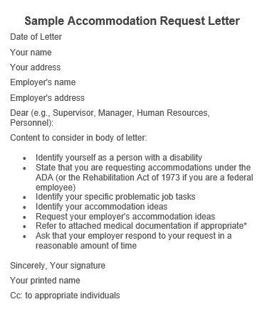
Tips on Requesting accommodations
Job Accommodation Network
Request sooner rather than later
Set up a meeting with your manager or supervisor
Be clear and specific
Can limit the amount of medical information you share
Can ask for more than one accommodation
Negotiate an agreed upon solution
Put it in writing!

Slide 23
Negotiating Beyond the Clinic
Know Your Rights in Education

Slide 24
Your Rights as a Student
Federal law requires post-secondary schools to offer equal access to people with disabilities
  Protection under Title II of ADA and Section 504 of the Rehabilitation Act of 1973
Accommodations may include:
  Extra time to complete assignments
  Permission to arrive late to certain classes if you need extra time to get across campus
  Copies of lecture notes
  Assistive technology such as electronic organizers, speech recognition software and screen readers
  Taking tests in a testing center to reduce distractions

Slide 25
Self Advocacy is Ongoing
“Now, and for the rest of your life, you must be self-aware, as others cannot, about subtle and not so subtle changes in symptoms such as pain, weakness, fatigue, or loss of appetite.”
-National Coalition for Cancer Survivorship

Slide 26
Survivorship Care Plan
What is it?
A record of your cancer and treatment history, checkups or follow-up tests you need in the future, list of possible long-term effects of your treatments, and ideas for staying healthy
Purpose:
Helps in care coordination
Encourages appropriate health monitoring and health promotion
Enhances communication among team (includes patient/family)
Identifies and manages long-term effects
Leads to referral to appropriate specialist if indicated
When do you receive it?
During cancer treatment or after treatment has ended
If you do not get one, ask your doctor!
ASCO Survivorship Care Plan

Slide 27
Tuning in to Your Support System
You are not alone
Family
Friends
Other Survivors
Social Worker
Therapist
Healthcare Team
Support Organizations

Slide 28
Finding Support
Connecting with Peers:
Dear Jack Community
Imerman Angels
Cancer specific organizations
Professional Support:
Cancer Care
800-813-4673
American Psychosocial Oncology Society (APOS)
866-276-7443
Psychology Today
Connect with Your Social Worker!
Referrals to local resources
Support groups
Psychosocial support

Slide 29
Key Take-aways
Self advocacy IS empowerment
Know yourself to advocate for yourself
Anyone can develop the skills to advocate for themselves
You don’t have to do it alone

Slide 30
Thank you!

Slide 31


